Slide 1
Operating Systems CSCI 3150
Lecture 7: Synchronization (III)
-- Semaphores

Slide 2

Semaphore
It provides
Mutex
And atomic counters
Two operations:
P(semaphore), Wait(): after the Dutch word for test
V(semaphore), signal(), post(): after the Dutch word for increment
Probably the most unintuitive names you encounter in this course
You have Edsger W. Dijkstra to thank to

Slide 3
Semaphore: A definition
An object with an integer value
We can manipulate with two routines; sem_wait() and sem_post().
Initialization
Declare a semaphore s and initialize it to the value 1
The second argument, 0, indicates that the semaphore is shared between threads in the same process.
#include <semaphore.h>
sem_t s;
sem_init(&s, 0, 1); // initialize s to the value 1

Slide 4
Semaphore: Interact with semaphore
sem_wait()
If the value of the semaphore was one or higher when called sem_wait(), return right away.
It will cause the caller to suspend execution waiting for a subsequent post.
When negative, the value of the semaphore is equal to the number of waiting threads.
1 int sem_wait(sem_t *s) {
2 decrement the value of semaphore s by one
3 wait if value of semaphore s is negative
4 }

Slide 5
Semaphore: Interact with semaphore (Cont.)
sem_post()
Simply increments the value of the semaphore.
If there is a thread waiting to be woken, wakes one of them up.
1 int sem_post(sem_t *s) {
2 increment the value of semaphore s by one
3 if there are one or more threads waiting, wake one
4 }

Slide 6
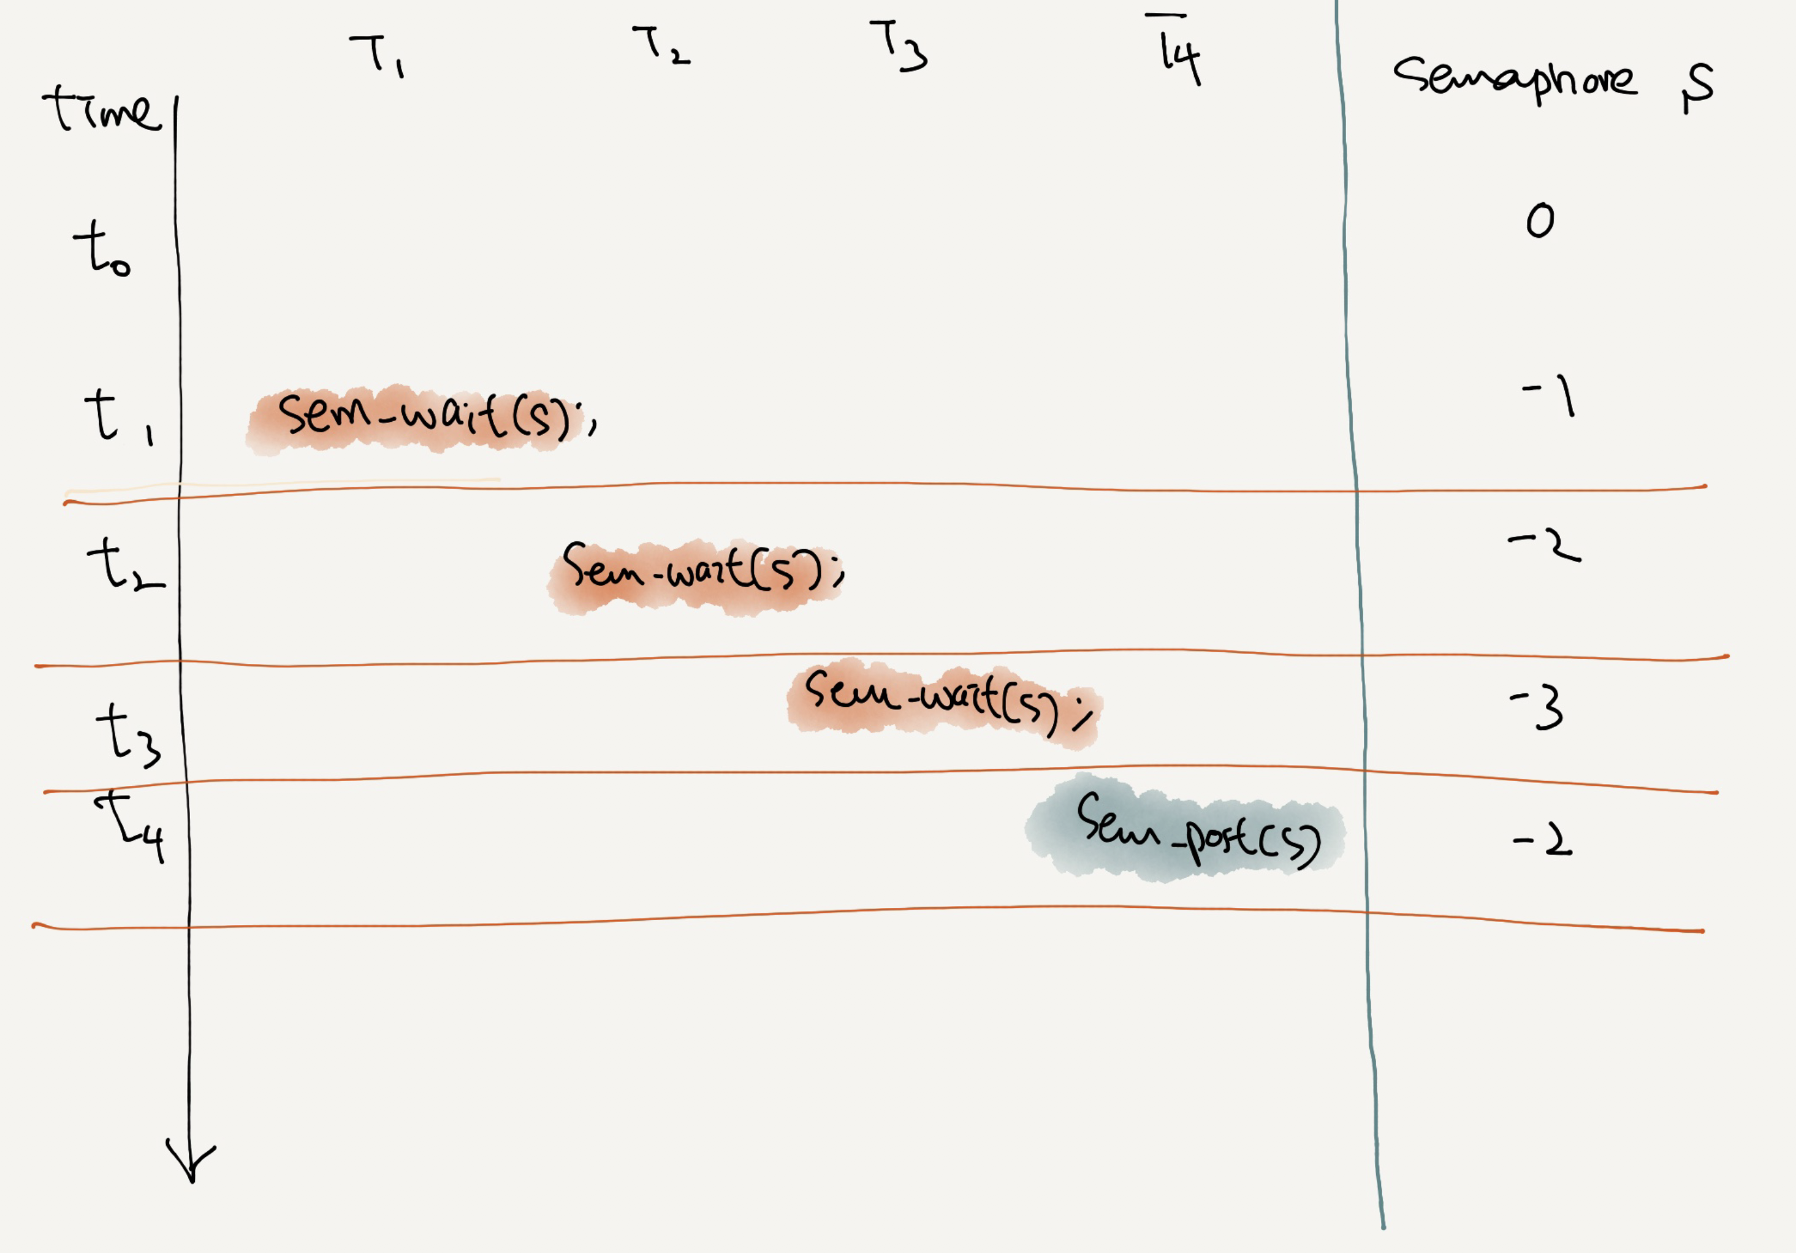

Slide 7
Binary Semaphores (Locks)
What should X be?
The initial value should be 1.
1 sem_t m;
2 sem_init(&m, 0, X); // initialize semaphore to X; what should X be?
3
4 sem_wait(&m);
5 //critical section here
6 sem_post(&m);
Value of Semaphore | Thread 0 | Thread 1
1
1 | call sema_wait()
0 | sem_wait() returns
0 | (crit sect)
0 | call sem_post()
1 | sem_post() returns

Slide 8
Thread Trace: Two Threads Using A Semaphore
Value | Thread 0 | State | Thread 1 | State
1 |  | Running |  | Ready
1 | call sem_wait() | Running |  | Ready
0 | sem_wait() returns | Running |  | Ready
0 | (crit set: begin) | Running |  | Ready
0 | Interrupt; Switch → T1 | Ready |  | Running
0 |  | Ready | call sem_wait() | Running
-1 |  | Ready | decrement sem | Running
-1 |  | Ready | (sem < 0)→sleep | sleeping
-1 |  | Running | Switch → T0 | sleeping
-1 | (crit sect: end) | Running |  | sleeping
-1 | call sem_post() | Running |  | sleeping
0 | increment sem | Running |  | sleeping
0 | wait(T1) | Running |  | Ready
0 | sem_post() returns | Running |  | Ready
0 | Interrupt; Switch → T1 | Ready |  | Running
0 |  | Ready | sem_wait() retruns | Running
0 |  | Ready | (crit sect) | Running
0 |  | Ready | call sem_post() | Running
1 |  | Ready | sem_post() returns | Running

Slide 9
Semaphores As Condition Variables
What should X be?
The value of semaphore should be set to is 0.
1 sem_t s;
2
3 void *
4 child(void *arg) {
5 printf("child\n");
6 sem_post(&s); // signal here: child is done
7 return NULL;
8 }
9
10 int
11 main(int argc, char *argv[]) {
12 sem_init(&s, 0, X); // what should X be?
13 printf("parent: begin\n");
14 pthread_t c;
15 pthread_create(c, NULL, child, NULL);
16 sem_wait(&s); // wait here for child
17 printf("parent: end\n");
18 return 0;
19 }
parent: begin
child
parent: end
A Parent Waiting For Its Child
The execution result

Slide 10
Thread Trace: Parent Waiting For Child (Case 1)
The parent call sem_wait() before the child has called sem_post().
Value | Parent | State | Child | State
0 | Create(Child) | Running | (Child exists; is runnable) | Ready
0 | call sem_wait() | Running |  | Ready
-1 | decrement sem | Running |  | Ready
-1 | (sem < 0)→sleep | sleeping |  | Ready
-1 | Switch→Child | sleeping | child runs | Running
-1 |  | sleeping | call sem_post() | Running
0 |  | sleeping | increment sem | Running
0 |  | Ready | wake(Parent) | Running
0 |  | Ready | sem_post() returns | Running
0 |  | Ready | Interrupt; Switch→Parent | Ready
0 | sem_wait() retruns | Running |  | Ready

Slide 11
Thread Trace: Parent Waiting For Child (Case 2)
The child runs to completion before the parent call sem_wait().
Value | Parent | State | Child | State
0 | Create(Child) | Running | (Child exists; is runnable) | Ready
0 | Interrupt; switch→Child | Ready | child runs | Running
0 |  | Ready | call sem_post() | Running
1 |  | Ready | increment sem | Running
1 |  | Ready | wake(nobody) | Running
1 |  | Ready | sem_post() returns | Running
1 | parent runs | Running | Interrupt; Switch→Parent | Ready
1 | call sem_wait() | Running |  | Ready
0 | decrement sem | Running |  | Ready
0 | (sem<0)→awake | Running |  | Ready
0 | sem_wait() retruns | Running |  | Ready

Slide 12
The Producer/Consumer (Bounded-Buffer) Problem
Producer: put() interface
Wait for a buffer to become empty in order to put data into it.
Consumer: get() interface
Wait for a buffer to become filled before using it.
1 int buffer[MAX];
2 int fill = 0;
3 int use = 0;
4
5 void put(int value) {
6 buffer[fill] = value; // line f1
7 fill = (fill + 1) % MAX; // line f2
8 }
9
10 int get() {
11 int tmp = buffer[use]; // line g1
12 use = (use + 1) % MAX; // line g2
13 return tmp;
14 }

Slide 13
The Producer/Consumer (Bounded-Buffer) Problem
1 sem_t empty;
2 sem_t full;
3
4 void *producer(void *arg) {
5 int i;
6 for (i = 0; i < loops; i++) {
7 sem_wait(&empty); // line P1
8 put(i); // line P2
9 sem_post(&full); // line P3
10 }
11 }
12
13 void *consumer(void *arg) {
14 int i, tmp = 0;
15 while (tmp != -1) {
16 sem_wait(&full); // line C1
17 tmp = get(); // line C2
18 sem_post(&empty); // line C3
19 printf("%d\n", tmp);
20 }
}
…
First Attempt: Adding the Full and Empty Conditions

Slide 14
The Producer/Consumer (Bounded-Buffer) Problem
Imagine that MAX is greater than 1
If there are multiple producers, race condition can happen.
It means that the old data there is overwritten.
We’ve forgotten here is mutual exclusion.
The filling of a buffer and incrementing of the index into the buffer is a critical section.
int main(int argc, char *argv[]) {
// …
sem_init(&empty, 0, MAX); // MAX buffers are empty to begin with…
sem_init(&full, 0, 0); // … and 0 buffer is full
// …
}
First Attempt: Adding the Full and Empty Conditions (Cont.)

Slide 15
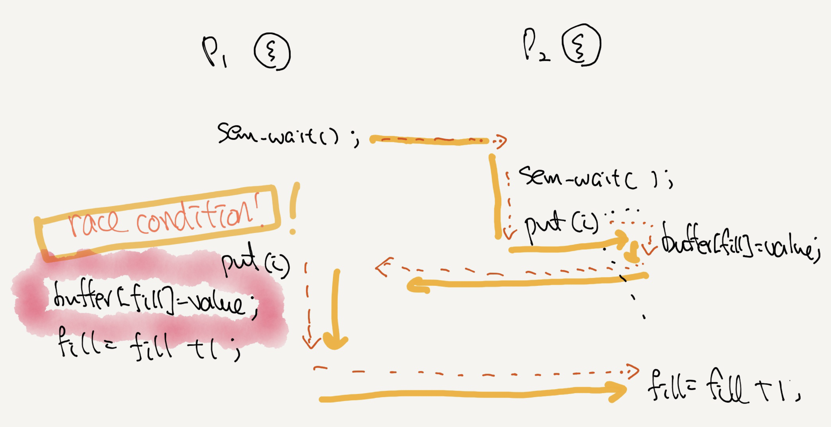

Slide 16
A Solution: Adding Mutual Exclusion
1 sem_t empty;
2 sem_t full;
3 sem_t mutex;
4
5 void *producer(void *arg) {
6 int i;
7 for (i = 0; i < loops; i++) {
8 sem_wait(&mutex); // line p0 (NEW LINE)
9 sem_wait(&empty); // line p1
10 put(i); // line p2
11 sem_post(&full); // line p3
12 sem_post(&mutex); // line p4 (NEW LINE)
13 }
14 }
15
Adding Mutual Exclusion (Incorrectly)

Slide 17
A Solution: Adding Mutual Exclusion
16 void *consumer(void *arg) {
17 int i;
18 for (i = 0; i < loops; i++) {
19 sem_wait(&mutex); // line c0 (NEW LINE)
20 sem_wait(&full); // line c1
int tmp = get(); // line c2
22 sem_post(&empty); // line c3
23 sem_post(&mutex); // line c4 (NEW LINE)
24 printf("%d\n", tmp);
25 }
26 }
Adding Mutual Exclusion (Incorrectly)

Slide 18
A Solution: Adding Mutual Exclusion (Cont.)
Imagine two thread: one producer and one consumer.
The consumer acquire the mutex (line c0).
The consumer calls sem_wait() on the full semaphore (line c1).
The consumer is blocked and yield the CPU.
The consumer still holds the mutex!
The producer calls sem_wait() on the binary mutex semaphore (line p0).
The producer is now stuck waiting too. a classic deadlock.

Slide 19
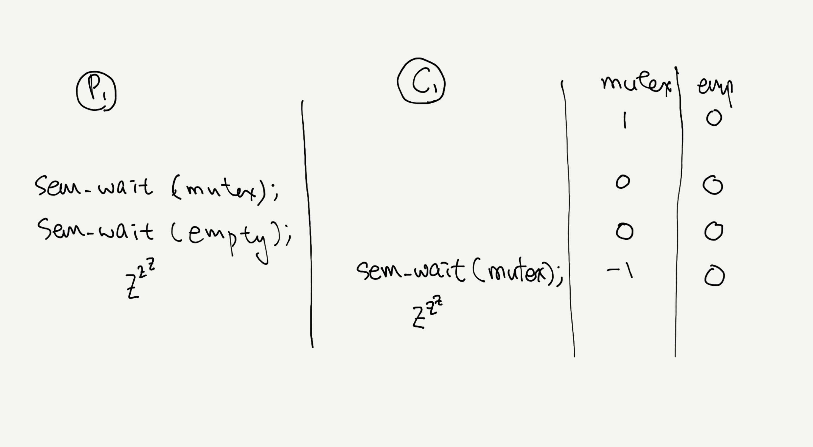

Slide 20
A Working Solution
1 sem_t empty;
2 sem_t full;
3 sem_t mutex;
4
5 void *producer(void *arg) {
6 int i;
7 for (i = 0; i < loops; i++) {
8 sem_wait(&empty); // line p1
9 sem_wait(&mutex); // line p1.5 (MOVED MUTEX HERE…)
10 put(i); // line p2
11 sem_post(&mutex); // line p2.5 (… AND HERE)
12 sem_post(&full); // line p3
13 }
14 }
15
Adding Mutual Exclusion (Correctly)

Slide 21
A Working Solution
16 void *consumer(void *arg) {
17 int i;
18 for (i = 0; i < loops; i++) {
19 sem_wait(&full); // line c1
20 sem_wait(&mutex); // line c1.5 (MOVED MUTEX HERE…)
21 int tmp = get(); // line c2
22 sem_post(&mutex); // line c2.5 (… AND HERE)
sem_post(&empty); // line c3
printf(“%d\n”, tmp);
}
}
int main(int argc, char *argv[]) {
// …
sem_init(&empty, 0, MAX); // MAX buffers are empty to begin with …
sem_init(&full, 0, 0); // ... and 0 are full
sem_init(&mutex, 0, 1); // mutex=1 because it is a lock
// …
}
…
Adding Mutual Exclusion (Correctly)

Slide 22
Reader-Writer Locks
Imagine a number of concurrent list operations, including inserts and simple lookups.
insert:
Change the state of the list
A traditional critical section makes sense.
lookup:
Simply read the data structure.
As long as we can guarantee that no insert is on-going, we can allow many lookups to proceed concurrently.
This special type of lock is known as a reader-write lock.

Slide 23
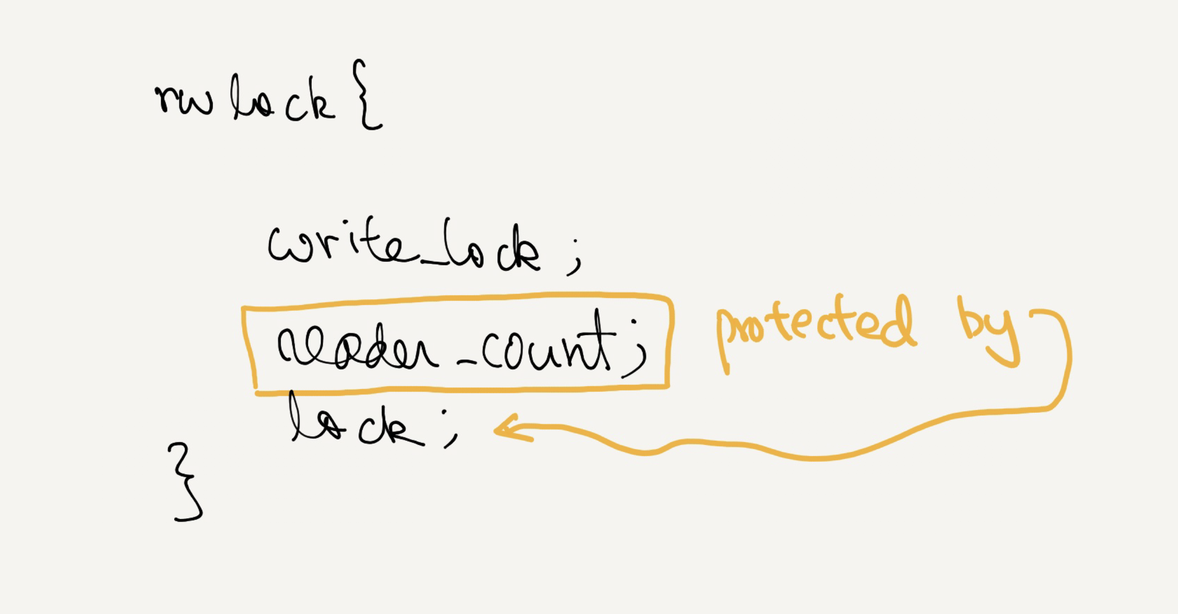

Slide 24
A Reader-Writer Locks
Only a single writer can acquire the lock.
Once a reader has acquired a read lock,
More readers will be allowed to acquire the read lock too.
A writer will have to wait until all readers are finished.
typedef struct _rwlock_t {
sem_t lock; // binary semaphore (basic lock)
sem_t writelock; // used to allow ONE writer or MANY readers
int readers; // count of readers reading in critical section
} rwlock_t;
void rwlock_init(rwlock_t *rw) {
rw->readers = 0;
sem_init(&rw->lock, 0, 1);
sem_init(&rw->writelock, 0, 1);
}

Slide 25
A Reader-Writer Locks
void rwlock_acquire_readlock(rwlock_t *rw) {
sem_wait(&rw->lock);
rw->readers++;
if (rw->readers == 1)
sem_wait(&rw->writelock); // first reader acquires writelock
sem_post(&rw->lock);
}
void rwlock_release_readlock(rwlock_t *rw) {
sem_wait(&rw->lock);
rw->readers--;
if (rw->readers == 0)
sem_post(&rw->writelock); // last reader releases writelock
sem_post(&rw->lock);
}

Slide 26
A Reader-Writer Locks (Cont.)
void rwlock_acquire_writelock(rwlock_t *rw) {
sem_wait(&rw->writelock);
}
void rwlock_release_writelock(rwlock_t *rw) {
sem_post(&rw->writelock);
}

Slide 27
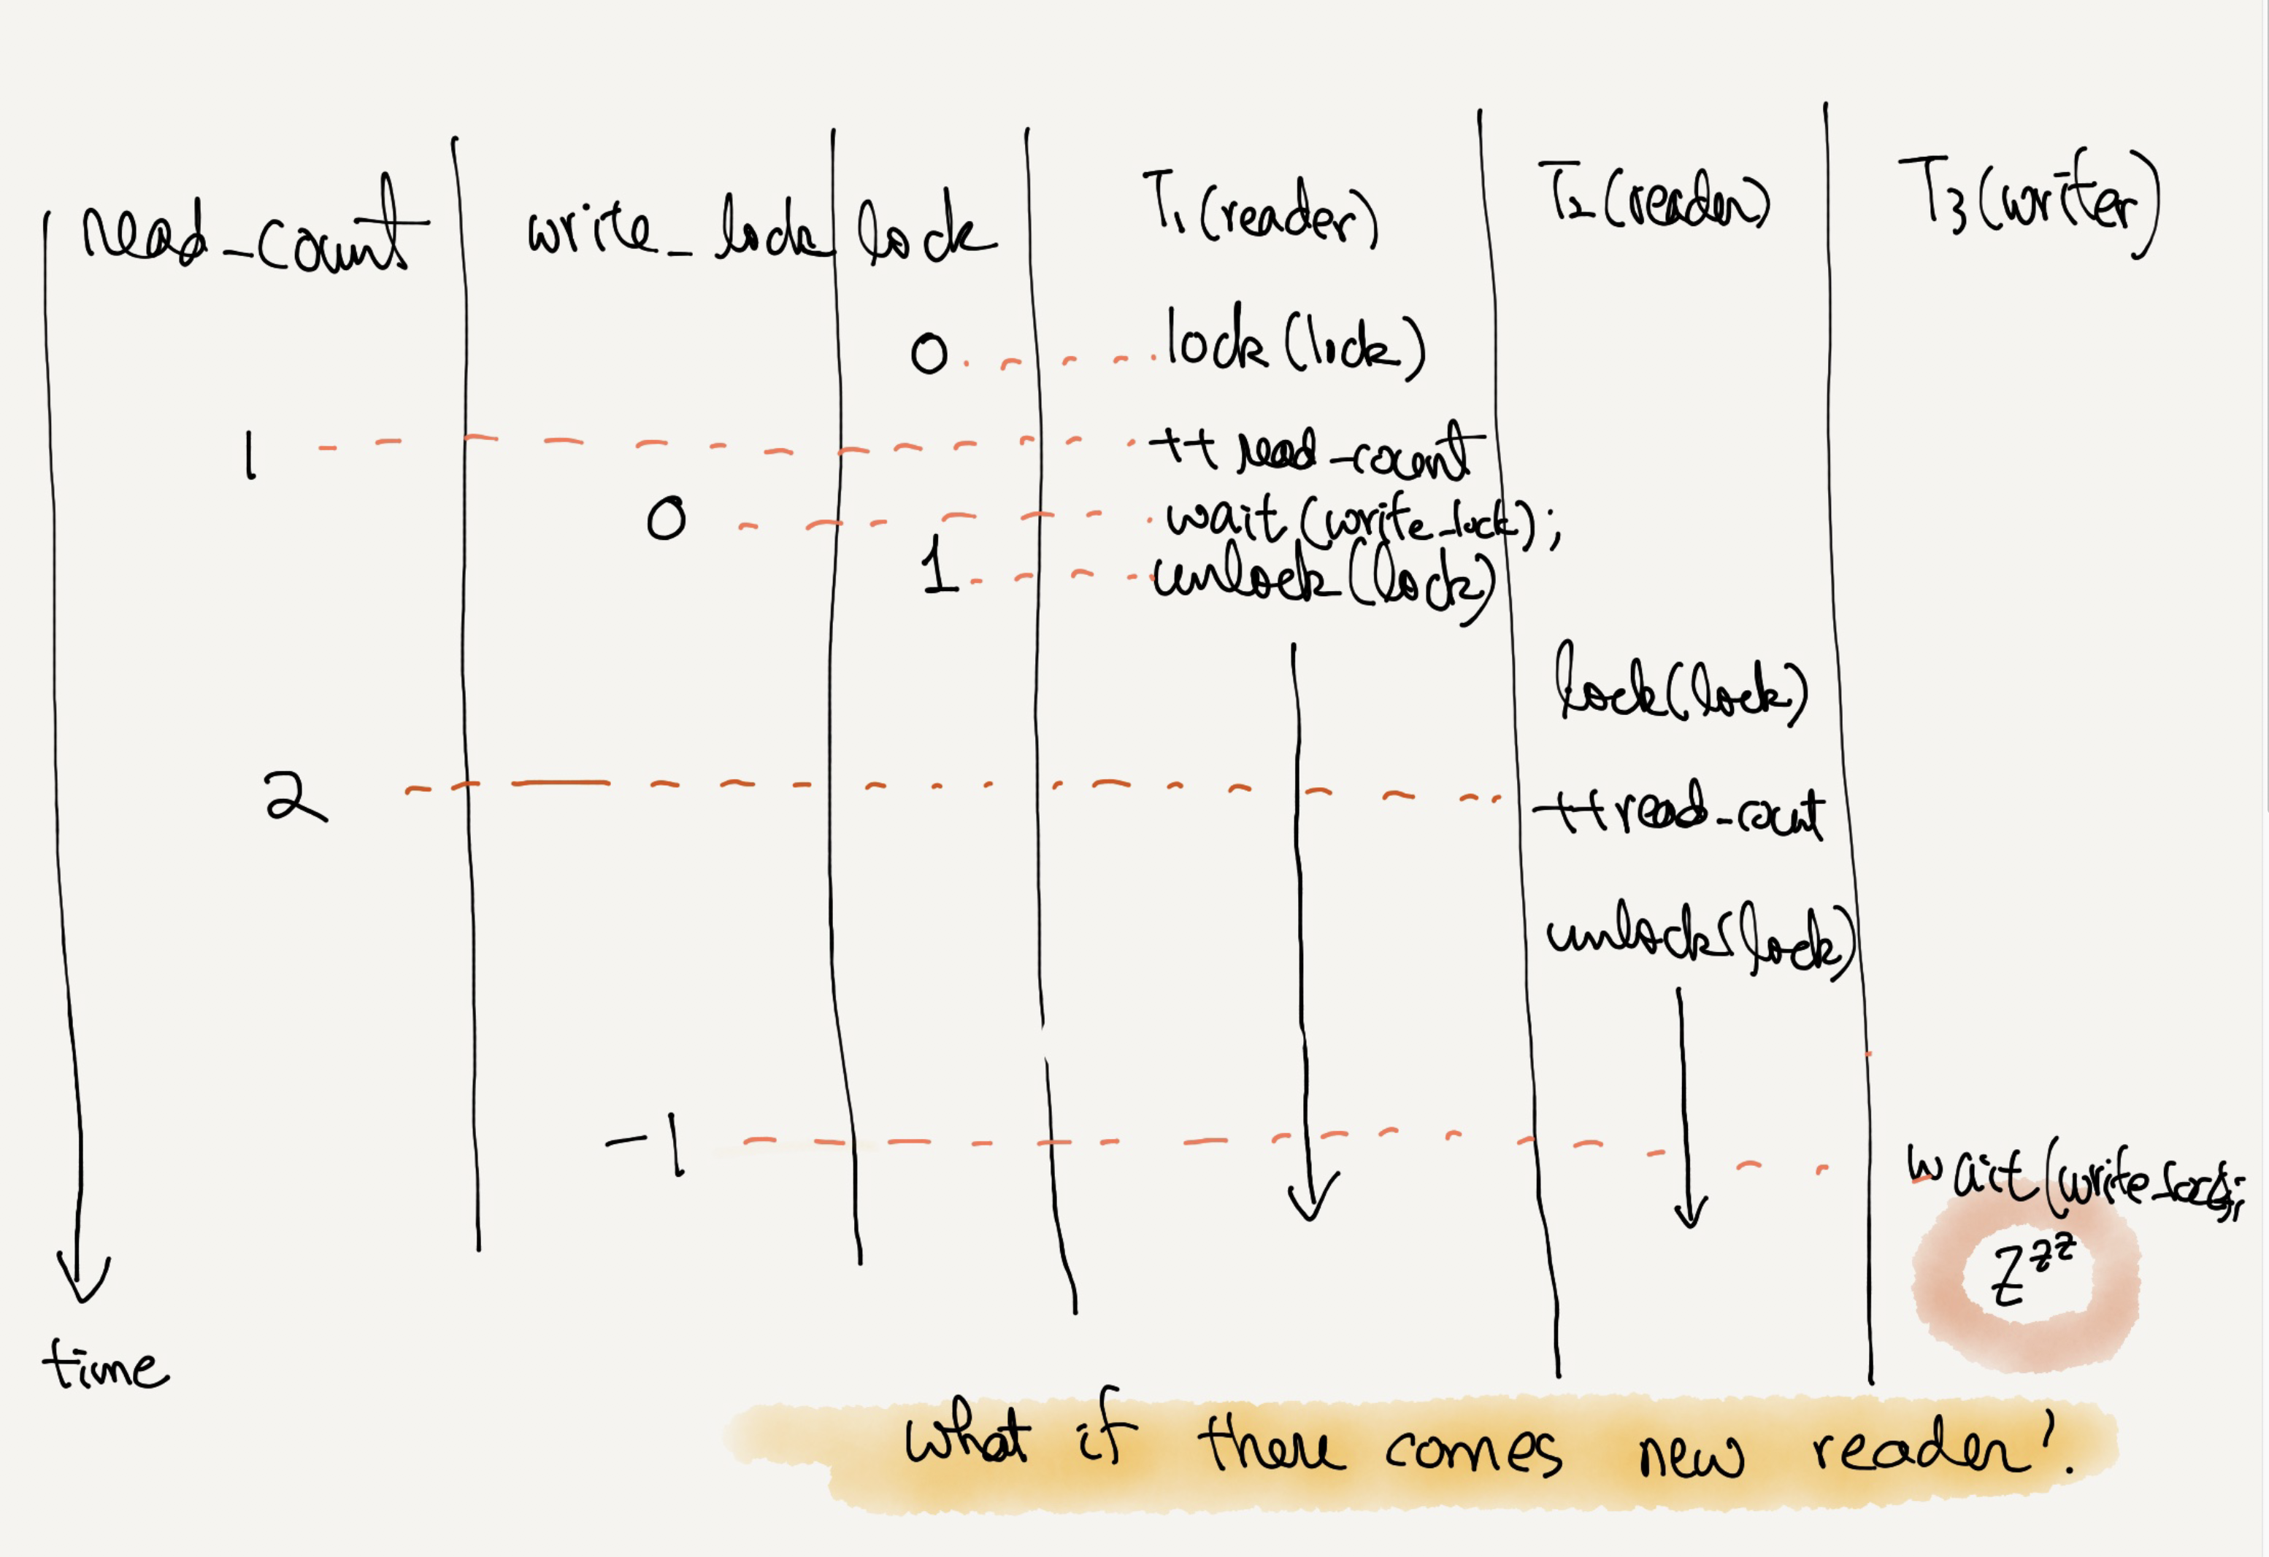

Slide 28
A Reader-Writer Locks (Cont.)
The reader-writer locks have fairness problem.
It would be relatively easy for reader to starve writer.
How to prevent more readers from entering the lock once a writer is waiting?

Slide 29
The Dining Philosophers
Assume there are five “philosophers” sitting around a table.
Between each pair of philosophers is a single fork (five total).
The philosophers each have times where they think, and don’t need any forks, and times where they eat.
In order to eat, a philosopher needs two forks, both the one on their left and the one on their right.
The contention for these forks.
P1
f2
f1
P2
P0
f3
f0
P3
P4
f4

Slide 30
The Dining Philosophers (Cont.)
Key challenge
There is no deadlock.
No philosopher starves and never gets to eat.
Concurrency is high.
Philosopher p wishes to refer to the fork on their left → call left(p).
Philosopher p wishes to refer to the fork on their right → call right(p).
while (1) {
think();
getforks();
eat();
putforks();
}
// helper functions
int left(int p) { return p; }
int right(int p) {
return (p + 1) % 5;
}
Basic loop of each philosopher
Helper functions (Downey’s solutions)

Slide 31
The Dining Philosophers (Cont.)
We need some semaphore, one for each fork: sem_t forks[5].
Deadlock occurs!
If each philosopher happens to grab the fork on their left before any philosopher can grab the fork on their right.
Each will be stuck holding one fork and waiting for another, forever.
void getforks() {
sem_wait(forks[left(p)]);
sem_wait(forks[right(p)]);
}
void putforks() {
sem_post(forks[left(p)]);
sem_post(forks[right(p)]);
}
The getforks() and putforks() Routines (Broken Solution)

Slide 32
A Solution: Breaking The Dependency
Change how forks are acquired.
Let’s assume that philosopher 4 acquire the forks in a different order.
There is no situation where each philosopher grabs one fork and is stuck waiting for another. The cycle of waiting is broken.
void getforks() {
if (p == 4) {
sem_wait(forks[right(p)]);
sem_wait(forks[left(p)]);
} else {
sem_wait(forks[left(p)]);
sem_wait(forks[right(p)]);
}
}

Slide 33
Semaphore using condition variable: Zemaphores
typedef struct __Zem_t {
int value;
pthread_cond_t cond;
pthread_mutex_t lock;
} Zem_t;
// only one thread can call this
void Zem_init(Zem_t *s, int value) {
s->value = value;
Cond_init(&s->cond);
Mutex_init(&s->lock);
}

Slide 34
Semaphore using condition variable: Zemaphores
void Zem_wait(Zem_t *s) {
Mutex_lock(&s->lock);
while (s->value <= 0)
Cond_wait(&s->cond, &s->lock);
s->value--;
Mutex_unlock(&s->lock);
}

Slide 35
How To Implement Semaphores (Cont.)
Zemaphores don’t maintain the invariant that the value of the semaphore, when negative, reflects the number of waiting threads.
The value never be lower than zero.
This behavior is easier to implement and matches the current Linux implementation.
void Zem_post(Zem_t *s) {
Mutex_lock(&s->lock);
s->value++;
Cond_signal(&s->cond);
Mutex_unlock(&s->lock);
}

Slide 36
Using semaphores to implement C.V.
It’s much more difficult!
Try it yourself

